Slide 1

Landmark Recognition
Group 13
Vu Hoang Nhat Anh – 20225471
Nguyen Huu Cong – 20225476
Nguyen Thanh Minh – 20225450
Tran Thanh Vinh - 20225539

Slide 2
Table of contents
Problem description
Dataset
Methodologies
Evaluation and Results
Demo

Slide 3
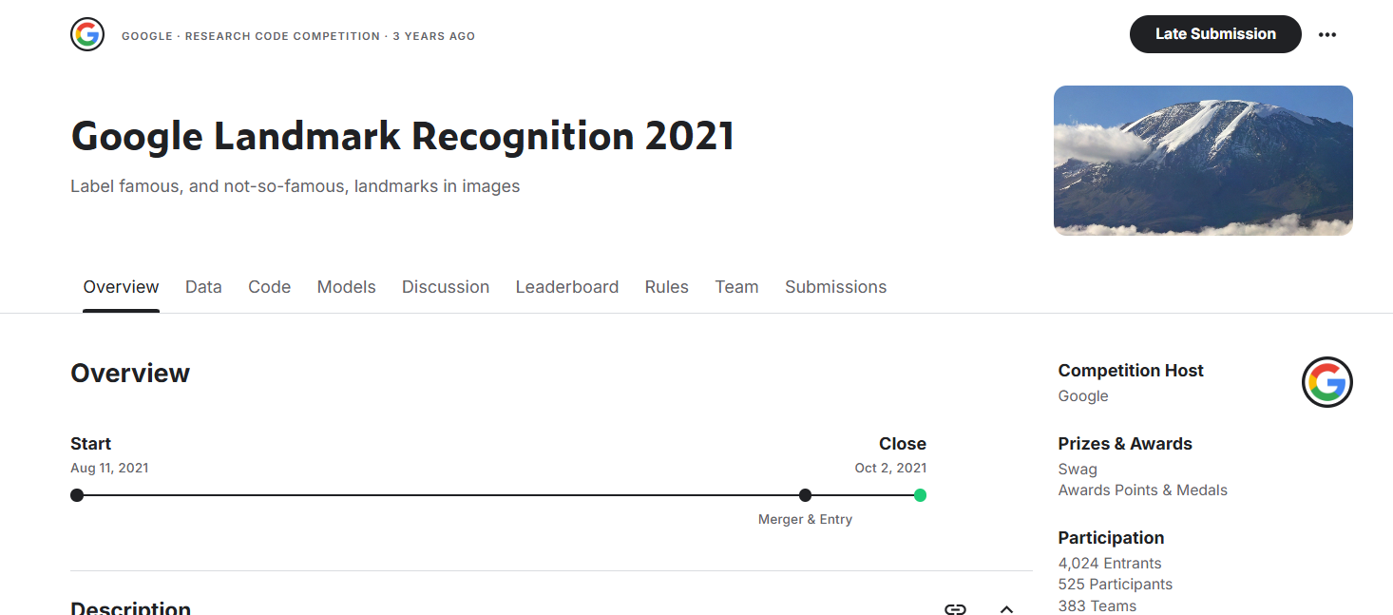
Problem Description
+) Landmark recognition is the task of automatically identifying and classifying landmarks—such as the Eiffel Tower or Grand Canyon—directly from image pixels using Machine learning/Deep learning models.
+) The project serves as an attempt at the Google Landmark Recognition 2021 competition hosted on Kaggle.
+) Goal: Develop models to recognize global landmarks from images and dealing with out of distribution images

Slide 4
Table of contents
Problem description
Dataset
Methodologies
Evaluation and Results
Demo

Slide 5
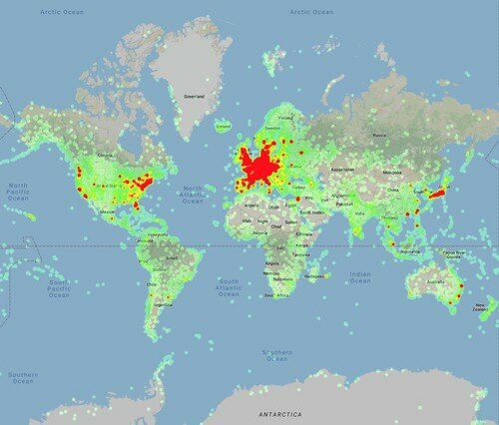
Dataset
+) Google Landmark Dataset v2 (GLDv2-clean): A large-scale dataset for instance-level recognition and retrieval.
+) Characteristics
1
Large-scale
To cover the entire world, a huge number of images are necessary
Heatmap of landmark’s occurences

Slide 6
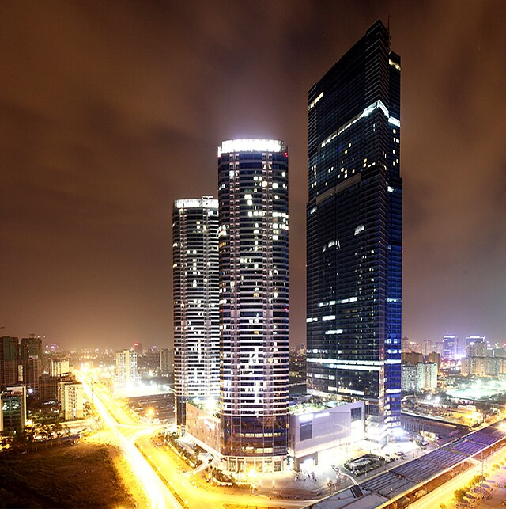
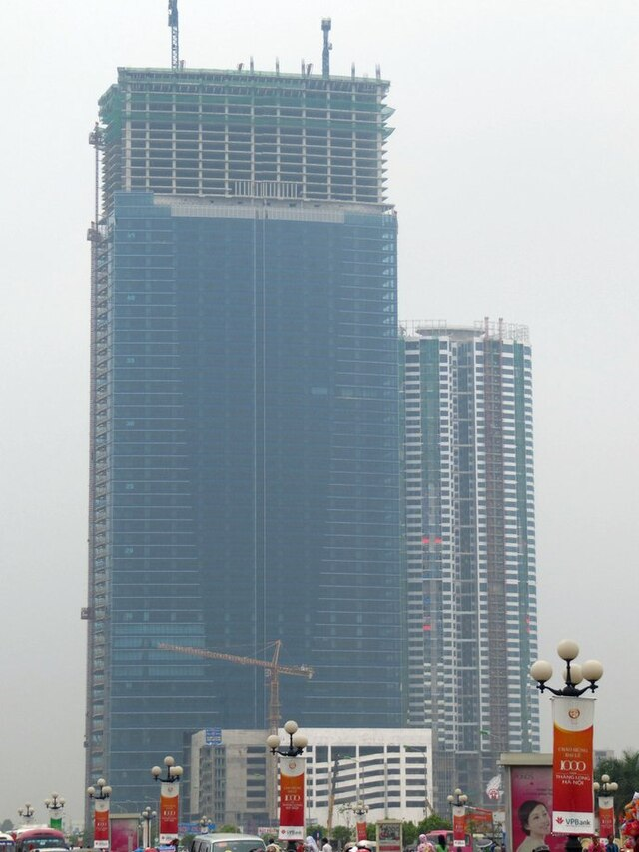
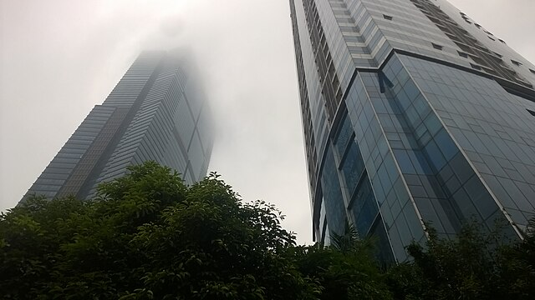
Dataset
+) Google Landmark Dataset v2 (GLDv2-clean): A large-scale dataset for instance-level recognition and retrieval.
+) Characteristics
2
Large-scale
Photos are taken under varying lighting conditions and from different views
Photos related to the landmark but not showing the full landmark itself
Images of Kangnam tower, Hanoi

Slide 7
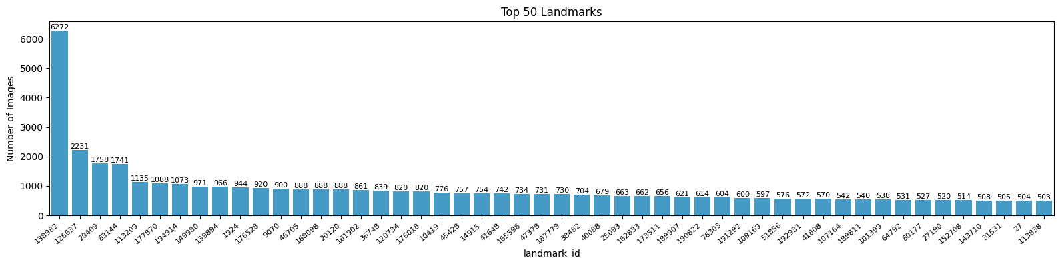
Dataset
+) Google Landmark Dataset v2 (GLDv2-clean): A large-scale dataset for instance-level recognition and retrieval.
+) Characteristics
2
Long-tailed class distribution
Much more photos of famous landmarks than lesser-known ones
Top 50 landmarks with corresponding number of images

Slide 8
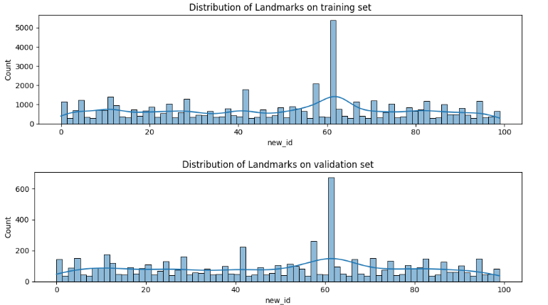
Our dataset
GLDv2-Clean remained too large for the scope of our project and the computational resources available to us
-> We select only the top 100 most frequently occurring landmark -> GLDv2-Use
The GLDv2-Use dataset is further divided into three subsets: training, validation, and test sets with stratified split to help maintaining class balance across all subsets
• Training set: 52,824 images
• Validation set: 6,606 images
• Test set: 6,651 images

Slide 9
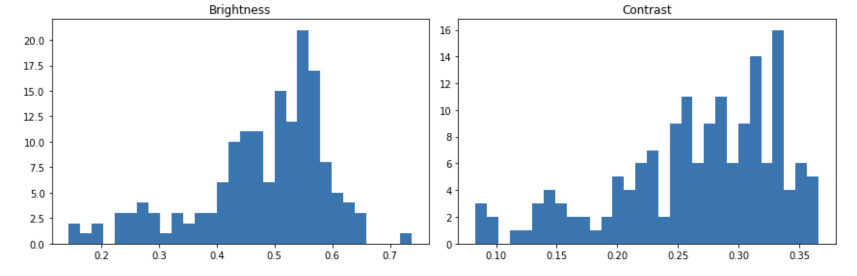
Exploratory Data Analysis
Brightness and Contrast Analysis
The dataset exhibits generally consistent brightness and contrast characteristics, which is
favorable for training a deep learning model.
However, some variation still exists. -> random brightness and contrast adjustments can be applied

Slide 10
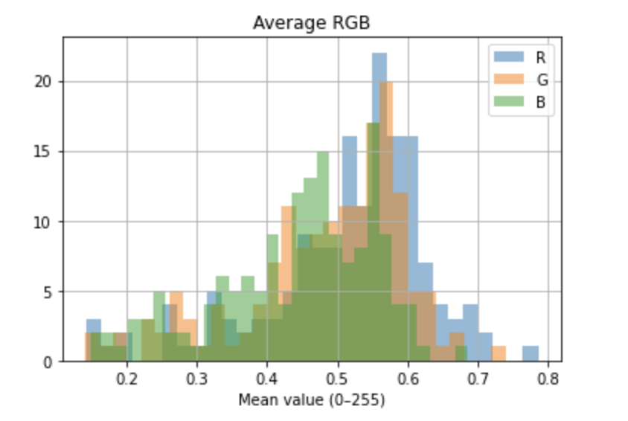
Exploratory Data Analysis
Average RGB Channel Analysis
The RGB distributions suggest a well-balanced color profile across the dataset,
Though with a slight dominance of warmer hues (higher R and G values). -> affect color sensitivity during training -> normalization across channels is essential for consistent model performance.

Slide 11
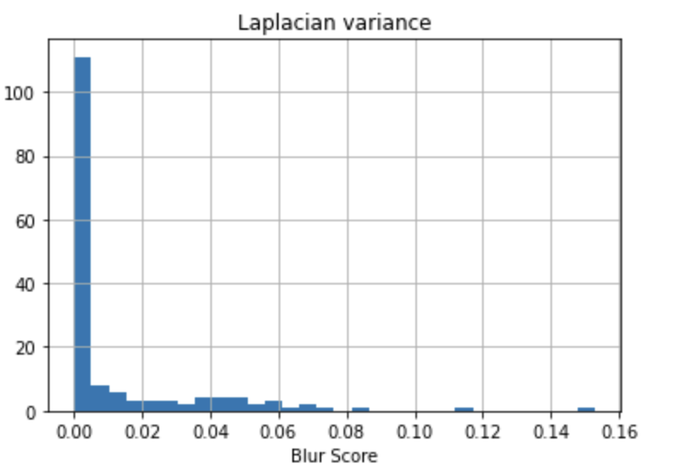
Exploratory Data Analysis
Image Sharpness Analysis (Laplacian Variance)
The dataset includes a significant proportion of blurry images, which could negatively impact model performance.
-> Apply Gaussian Blur that simulate focus and defocus conditions for robustness

Slide 12
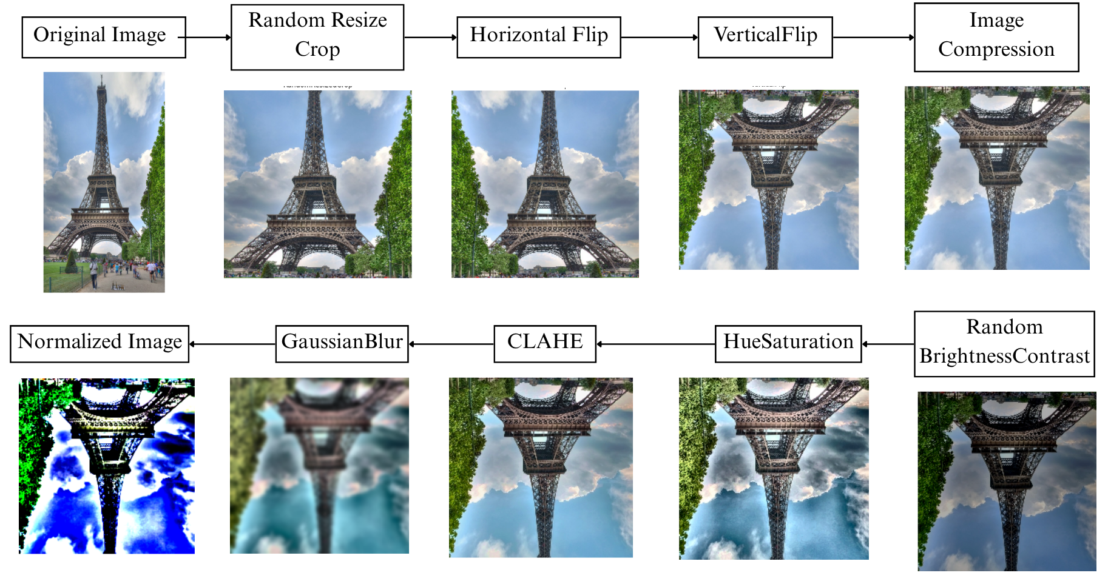
Data Preprocessing
Based on data analysis, we purpose 2 preprocess pipelines:
Pipeline 1:

Slide 13
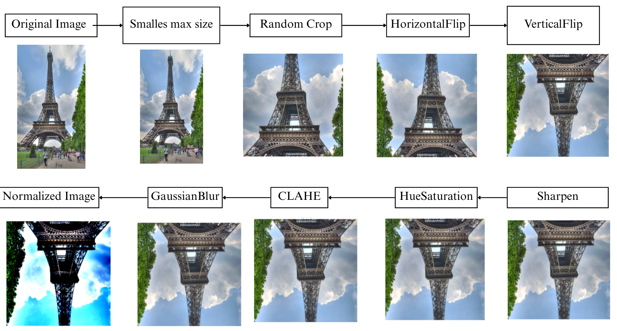
Data Preprocessing
Based on data analysis, we purpose 2 preprocess pipelines:
Pipeline 2:

Slide 14
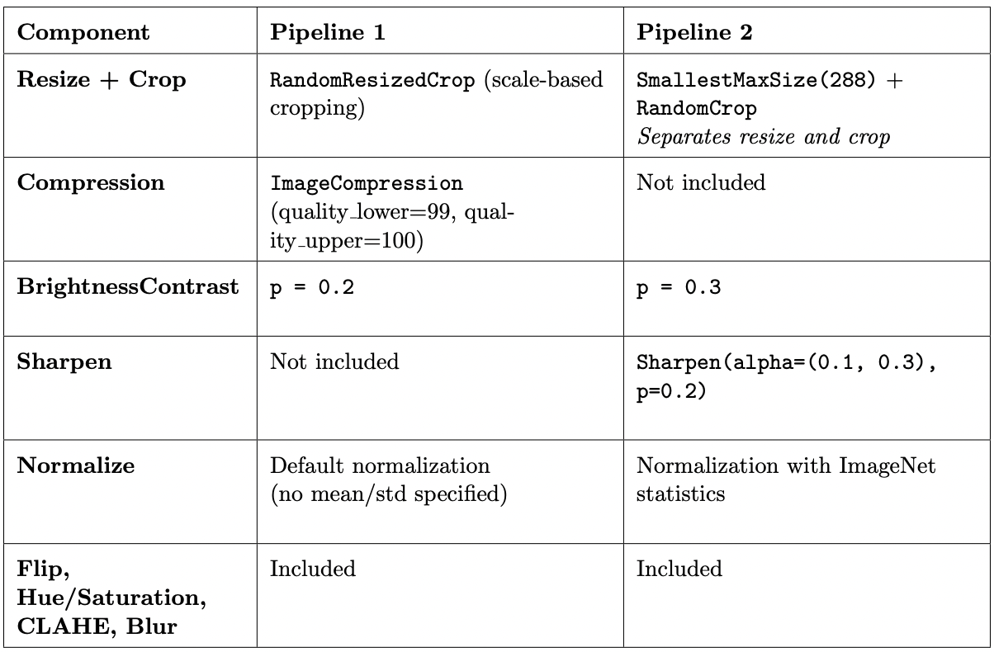
Data Preprocessing

Slide 15
Table of contents
Problem description
Dataset
Methodologies
Evaluation and Results
Demo

Slide 16
Methodologies
We introduce 4 approaches for the task of landmark recognition
+) 2 approaches to recognize landmark using global features by training a deep learning model
+) 2 hybrid approaches to investigate both global and local features of an image
 | Use Local Features | Use Global Features
ResNet-50 | ❌ | ✅
EfficientNet B2 | ❌ | ✅
EfficientNet B2 with Deep Local Features (DELF) | ✅ | ✅
Resnet50 with Deep Orthogonal Local and Global (DOLG) | ✅ | ✅

Slide 17
Models Application
Resnet50
EfficentNet

Slide 18
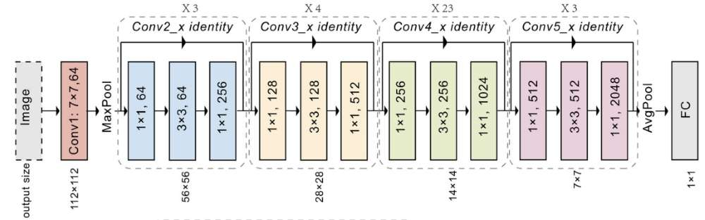
Models Application
Resnet50
A deep convolutional neural network (CNN) using residual learning to enable very deep architectures.
ResNet-50 includes a series of convolutional and identity blocks that incorporate residual connections
Addresses vanishing gradient issues, improving feature extraction in complex images.
ResNet50 Architecture

Slide 19
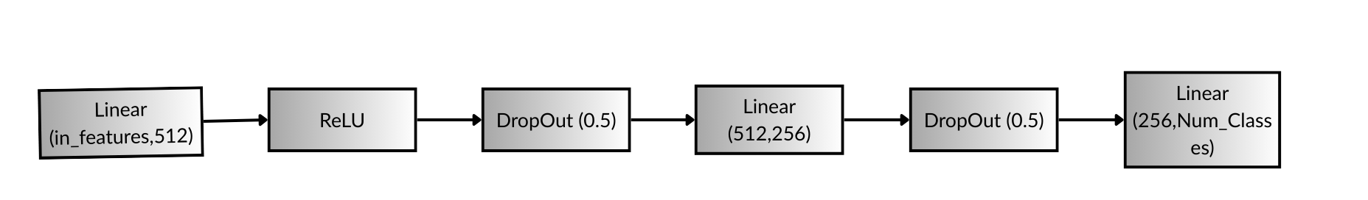
Models Application
Resnet50
Replace the original resnet_v1.fc (which was just Linear(2048, 1000) for ImageNet) with a custom head
Deeper head: Three linear layers instead of one.
Progressive dimensionality reduction: 2048 → 512 → 256 → NUM_CLASSES.
Non-linearities: ReLU after each linear layer to add non-linearity.
Dropout (0.5): Added for regularization to prevent overfitting — a strong regularization strategy when using deep fully connected layers.
Custom head Architecture

Slide 20
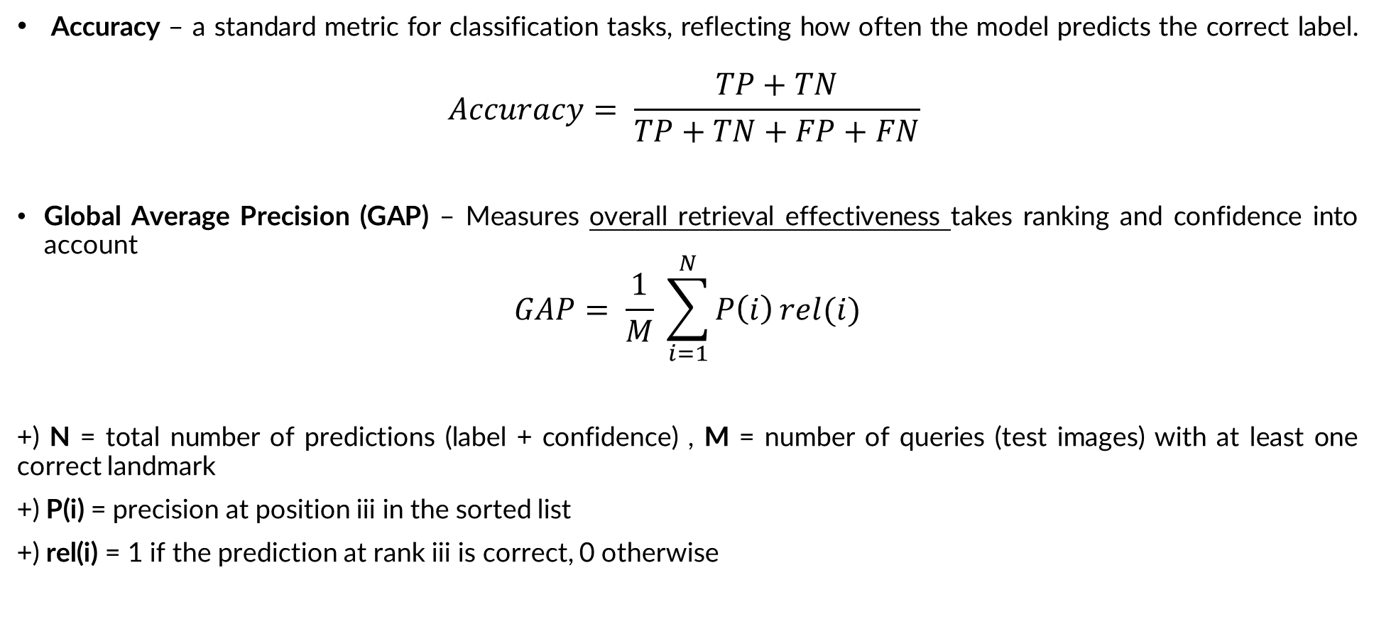
Evaluation Metrics
Accuracy – a standard metric for classification tasks, reflecting how often the model predicts the correct label.
$$Accuracy= \frac{TP+TN}{TP+TN+FP+FN}$$
Global Average Precision (GAP) – Measures overall retrieval effectiveness takes ranking and confidence into account
$$GAP= \frac{1}{M} \sum_{i=1}^{N}{P\left(i\right)}rel(i)$$
+) N = total number of predictions (label + confidence) , M = number of queries (test images) with at least one correct landmark
+) P(i) = precision at position iii in the sorted list
+) rel(i) = 1 if the prediction at rank iii is correct, 0 otherwise

Slide 21
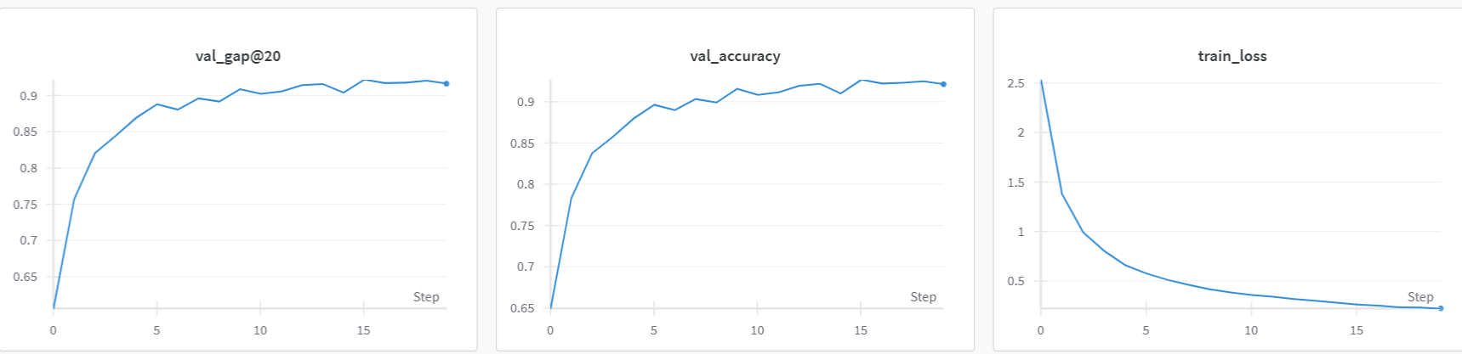
Methodologies
ResNet-50 Training
We trained the model ResNet50 using two different augmentation pipelines for 20 epochs and retrieve the evaluation results from it
The model is trained using Kaggle T4(x2) GPU, providing the necessary acceleration for handling the dataset and model complexity.
Metrics | Score
GAP | 0.9025
Accuracy | 0.9211
ResNet50 pipeline 1

Slide 22
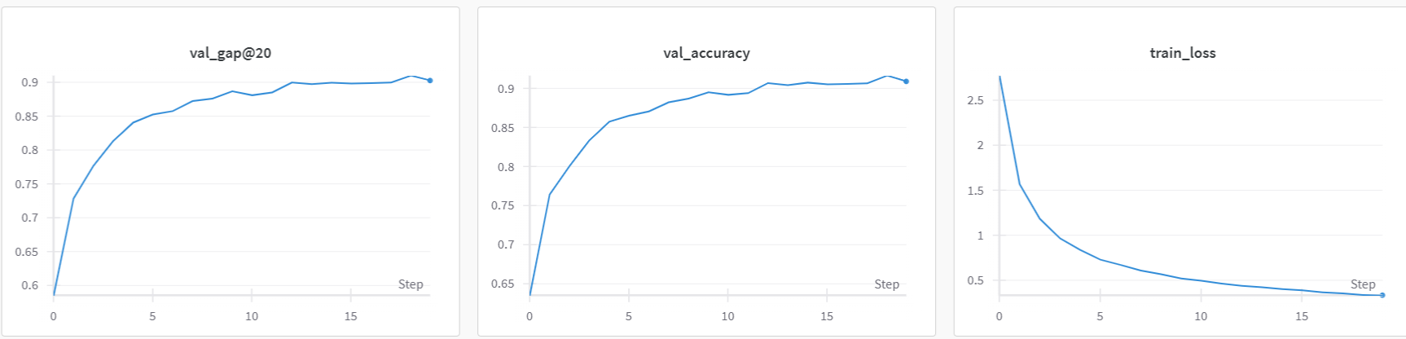
Methodologies
ResNet-50 Training
We trained the model ResNet50 using two different augmentation pipelines for 20 epochs and retrieve the evaluation results from it
The model is trained using Kaggle T4(x2) GPU, providing the necessary acceleration for handling the dataset and model complexity.
Metrics | Score
GAP | 0.9053
Accuracy | 0.9087
ResNet50 pipeline 2

Slide 23
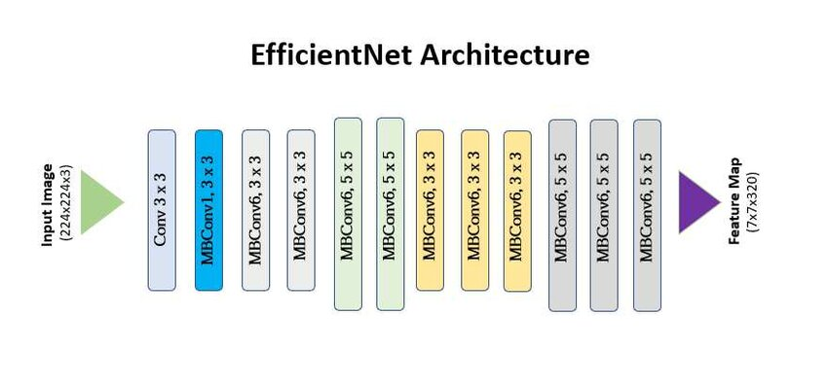
Models Application
EfficientNet-B2
A highly efficient CNN architecture that optimally balances depth, width, and resolution for better performance.
Achieves superior accuracy while using fewer parameters compared to traditional CNNs, making it more computationally efficient.
In this work, we utilize the EfficientNet-B2 variant, which offers a good trade-off between accuracy and computational cost for mid-sized models.
EfficientNet model Architecture

Slide 24
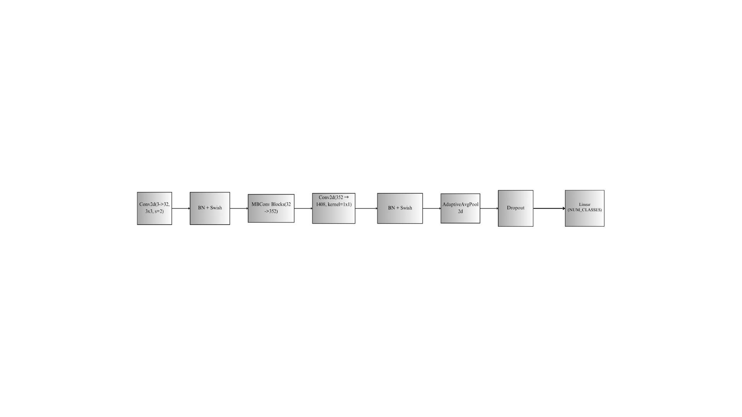
Models Application
EfficientNet-B2
Conv2d (3→32, stride=2): Extracts low-level features and reduces spatial size.
MBConv Blocks (32→352): Core EfficientNet blocks for efficient and deep feature extraction.
Conv2d (352→1408) + BN + Swish: Expands channels, normalizes, and adds non-linearity.
AdaptiveAvgPool2d + Dropout: Aggregates global features and helps prevent overfitting.
Custom classifier head with dropout and fully connected layer for NUM_CLASSES

Slide 25

Methodologies
EfficientNet-B2 Training
We trained the model EfficientNet-B2 using two different augmentation pipelines for 20
The model is trained using Kaggle T4(x2) GPU
Loss function: CrossEntropyLoss
Optimizer: Adam
Learning rate: 1e-4
Weight decay: 1e-4
Metrics | Score
GAP | 0.9687
Accuracy | 0.9703
EfficientNet-B2 pipeline 1

Slide 26
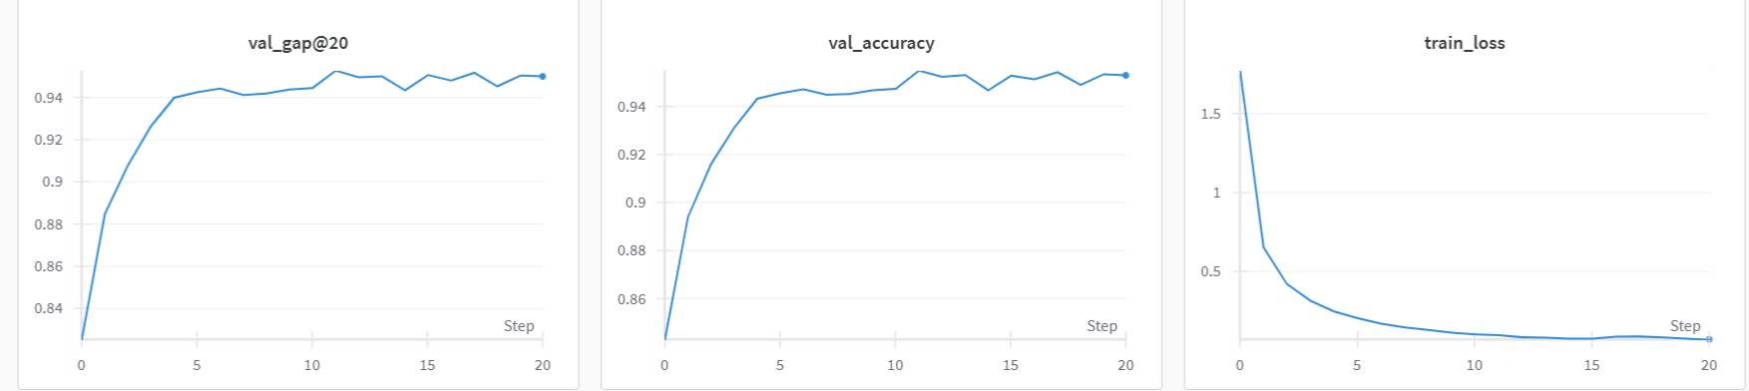
Methodologies
EfficientNet-B2 Training
We trained the model EfficientNet-B2 using two different augmentation pipelines for 20
The model is trained using Kaggle T4(x2) GPU
Loss function: CrossEntropyLoss
Optimizer: Adam
Learning rate: 1e-4
Weight decay: 1e-4
Metrics | Score
GAP | 0.9493
Accuracy | 0.9529
EfficientNet-B2 pipeline 2

Slide 27
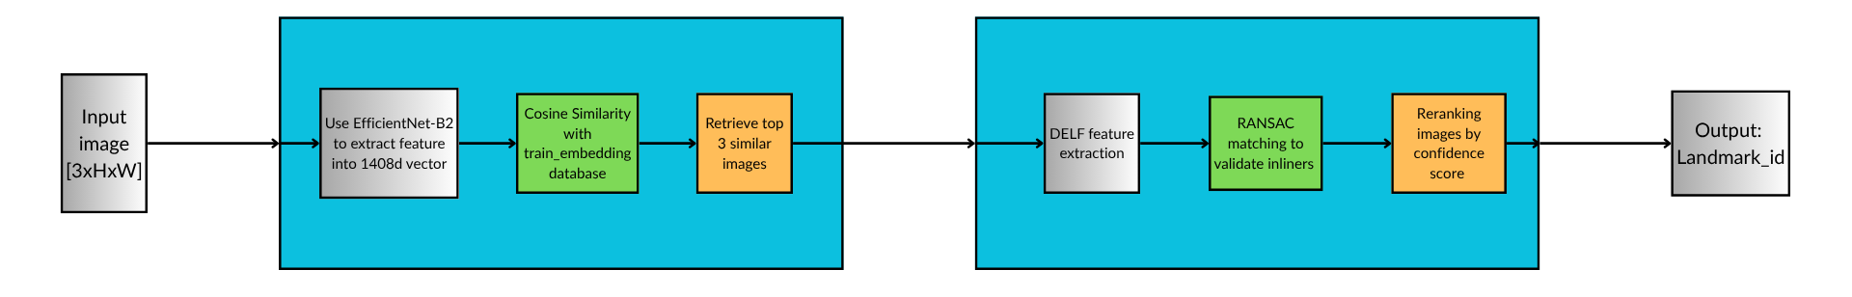
Methodologies
EfficientNet-B2 with Deep Local Features (DELF)
A hybrid approach combining both global descriptors (EfficientNetB2) and local features (DELF + RANSAC)
2 stages:
+) Embedding stage: return a shortlist of visually similar images likely to contain the same landmark
+) Re-ranking stage: return a precise, verified match based on both appearance and geometry.
=> This structure combines global appearance and local detail, making it robust to viewpoint changes and visually similar landmarks — ideal for accurate landmark recognition.
Embedding stage
Re-ranking stage
EfficientNet-B2 with Deep Local Features (DELF) Archtecture

Slide 28
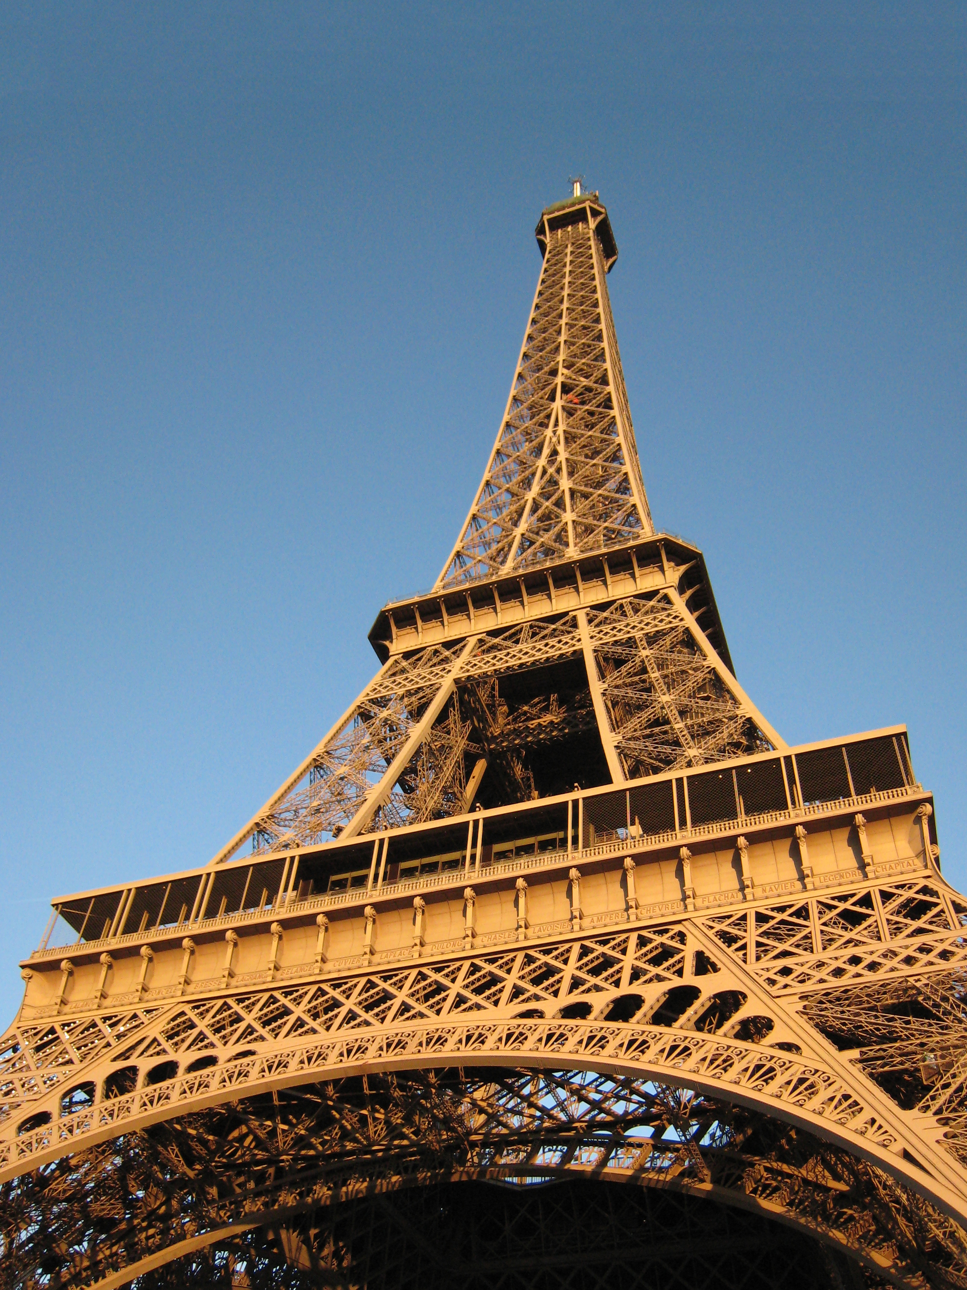
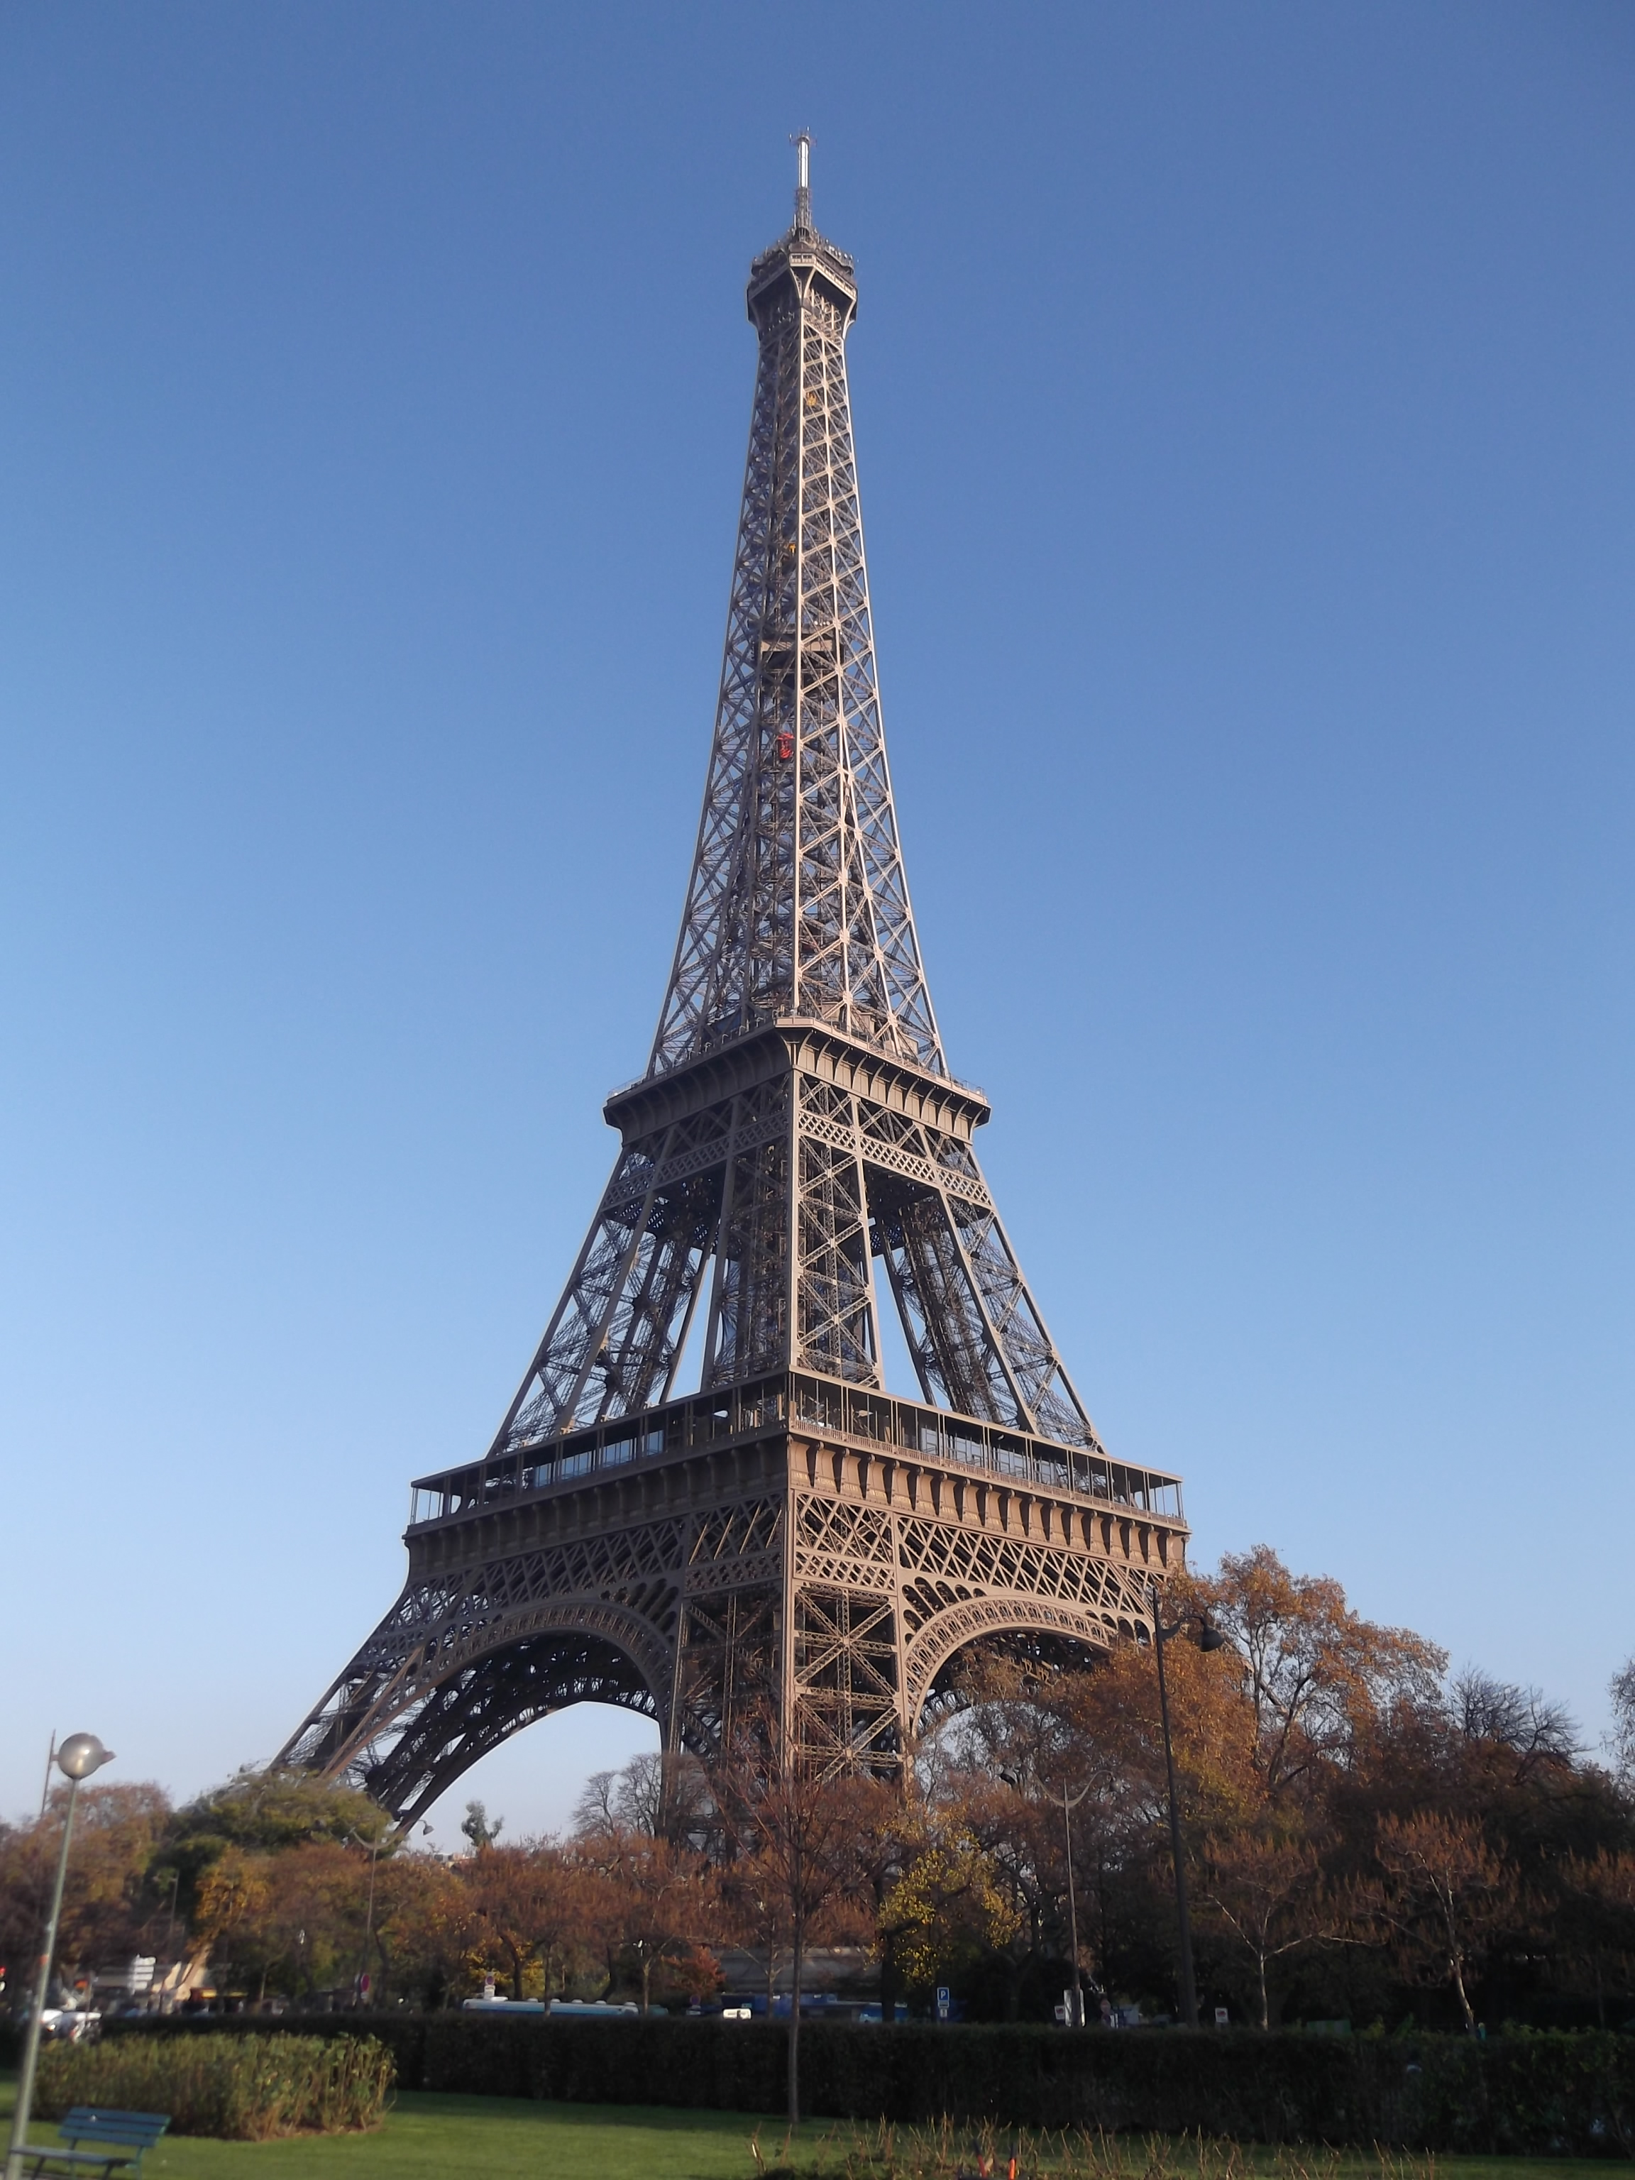
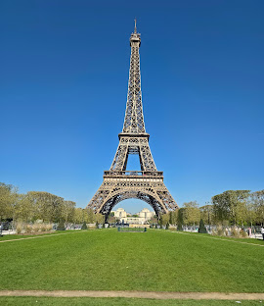
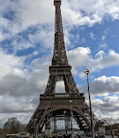
Methodologies
Phase 1: Embedding stage
We use our trained EfficientNet model from above section, replace the final FC layer to have a 1408-dimensional vector.
For each input image, cosine similarities is calculated between its global descriptor and all descriptors in the gallery (train set).
=> Extract the top-N most similar images
EfficientNet-B2 embedding model
[-0.14124638 -0.17163992 0.08363079 0.00568818
….
-0.18406282 -0.15699807 -0.19618554 -0.03694291 -0.14415942]
Calcualte Cosine Similarity

Slide 29
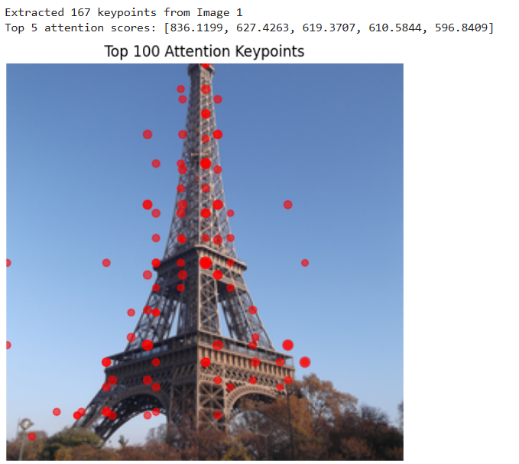
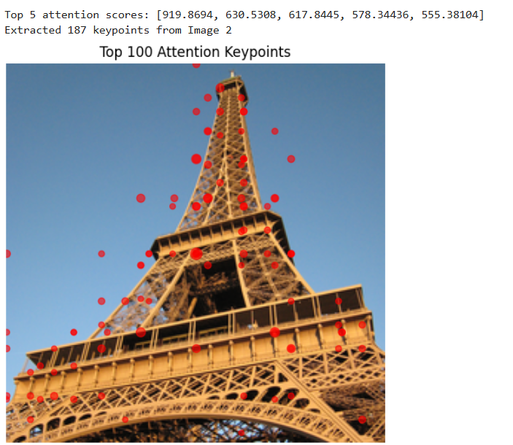
Methodologies
Phase 2 : Re-ranking stage: DELF Attention Key features:
Apply a pretrained model from DELF library to extract dense local features

Slide 30
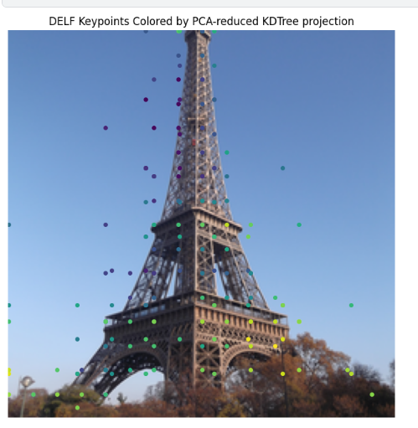
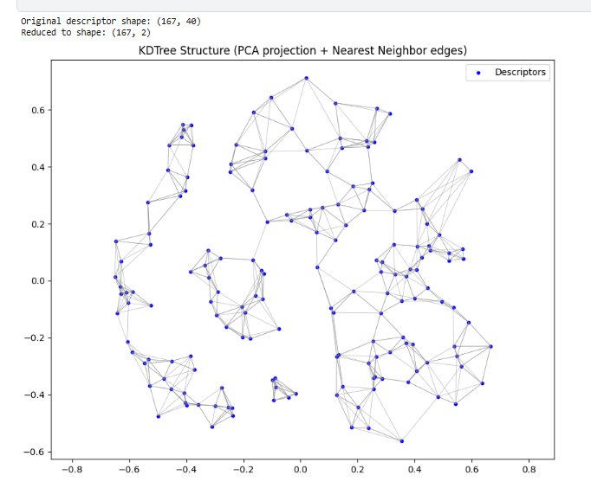
Methodologies
Phase 2 : Re-ranking stage DELF Attention Key features:
Builds a KDTree on the local descriptors from input image and each retrieved image, then queries the input with retrieved ones

Slide 31
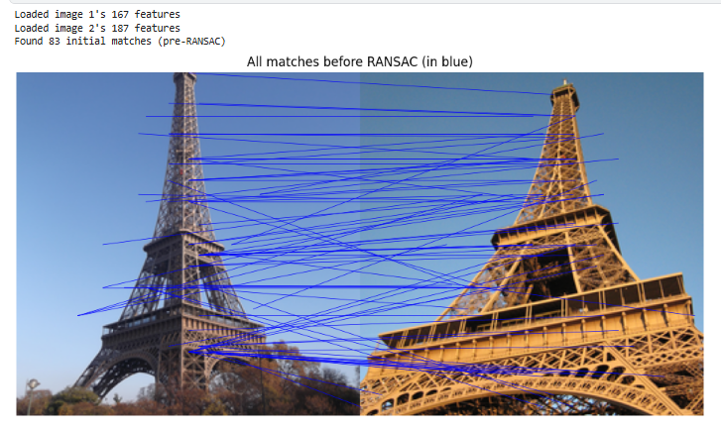
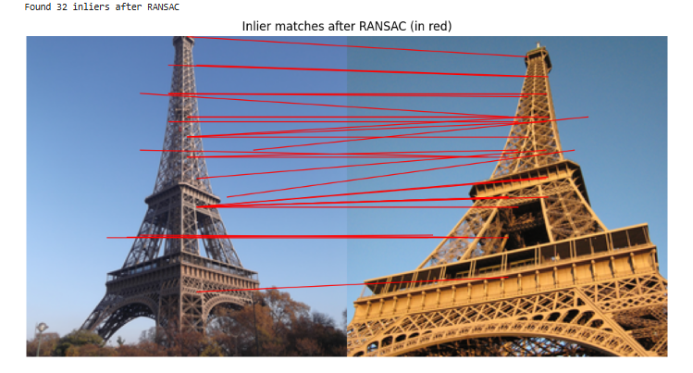
Methodologies
Phase 2: Reranking images
Use RANSAC + AffineTransform to remove spatial outliers and verify geometric consistency, results in "Inliners" points that fit this.
The best candidate after RANSAC is the final verified match, use for reranking process.

Slide 32
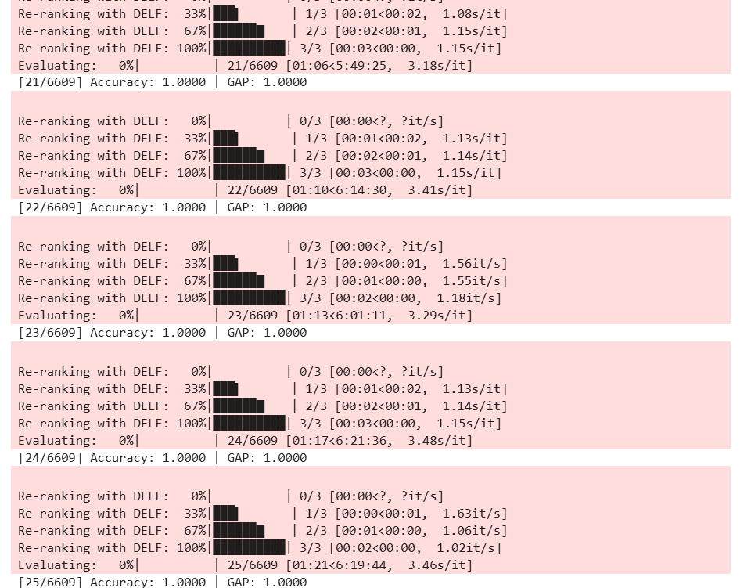
Methodologies
Output
The retrieved images are reranked based on the confidence score
This balances semantic similarity (global) and geometric match quality (local).
The final top1 image is used as the output landmark_id for the query image
Accuracy | GAP
0.9845 | 0.9832

Slide 33
Methodologies
Advantages and Disadvantages of EfficientNet + DELF
The method is good, but is it though
Advantages | Disadvantages
+) Strong Performance in Matching +) End-to-End Learning +) Robust to transformations +) Scalable: works well on large-scale datasets | +) Error exist inevitably in both stage +) RANSAC require high computational resource +) Suffer from error accumulation may lead to bottleneck for further performance improvement

Slide 34
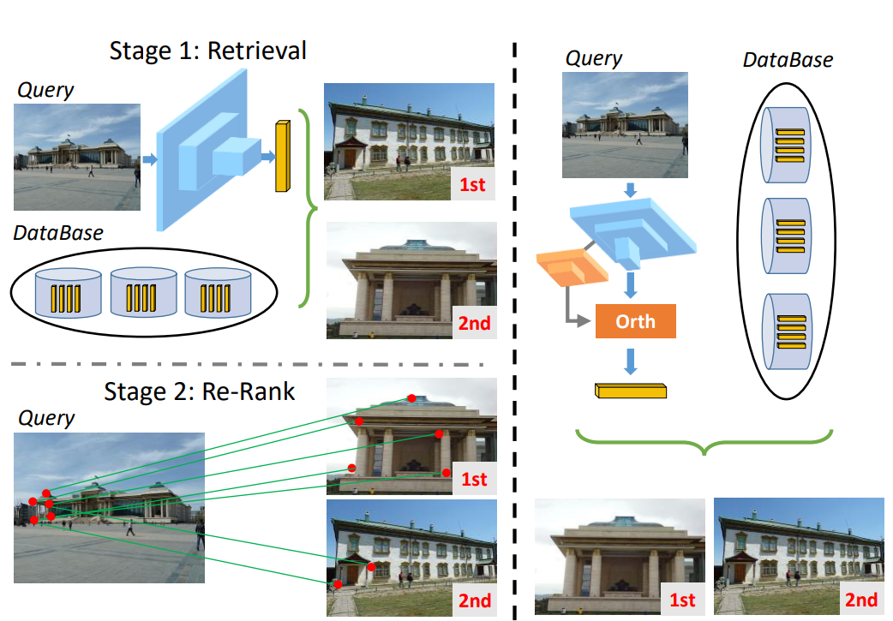
Proposed methods
Resnet50 with Deep Orthogonal Local and Global (DOLG)
The method aggregates global and local features via an orthogonal fusion to generate the final compact descriptor, then single-shot similarity search is performed
DELF
DOLG

Slide 35
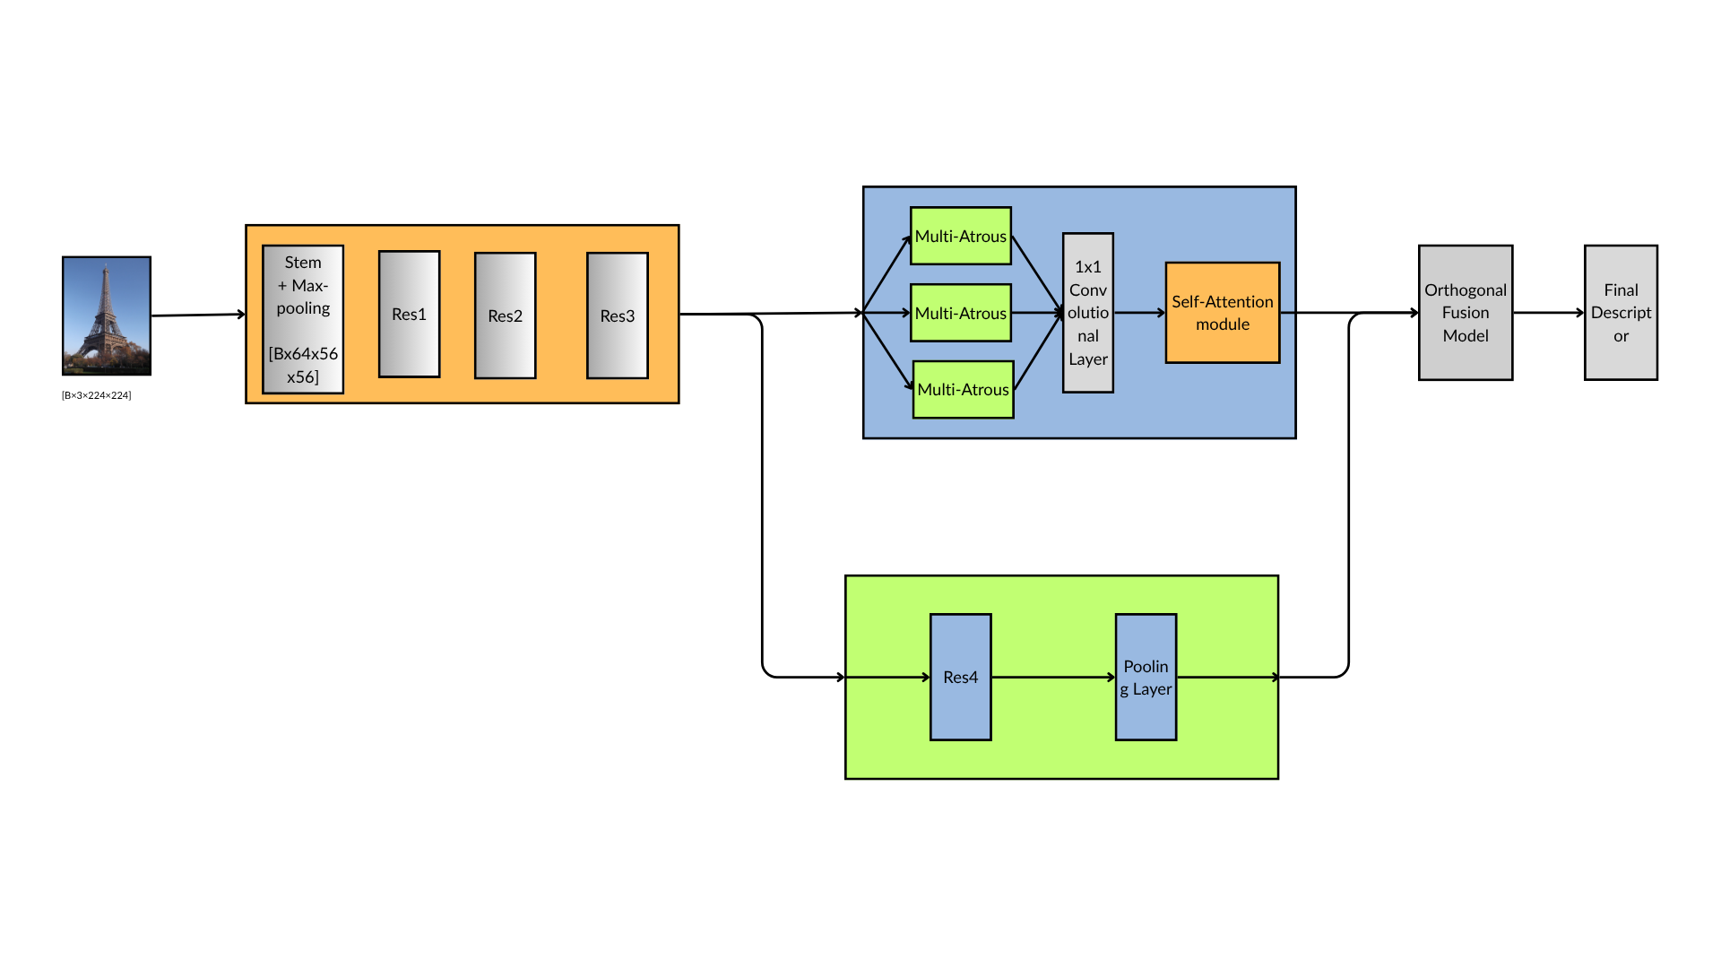
Proposed methods
Resnet50 with Deep Orthogonal Local and Global (DOLG)
Using ResNet50 model, build local branch and global branch after Res3
The local branch uses multi-atrous layers to simulate spatial pyramid to consider scale variations among images
The global branch generates a descriptor, which is fed into an orthogonal fusion module together with the local features for integrating both types of features
Local branch
[Bx3x224x224]
Global branch

Slide 36
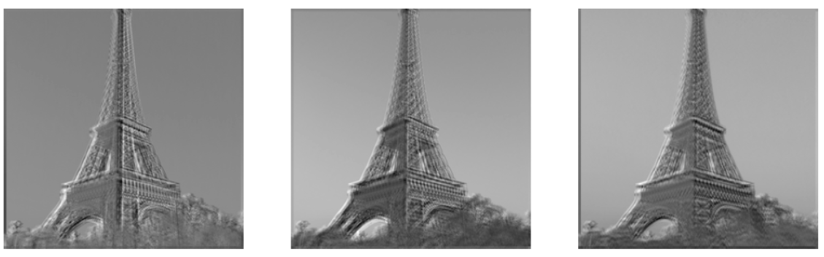
Proposed methods
Resnet50 with Deep Orthogonal Local and Global (DOLG)
Local branch: The two main building blocks of Local Branch are Multi-Atrous Convolutional Layer and Self-Attention Module
By using multiple dilation rates in different convolution layers, DOLG can capture information at different scales
=> Helps the model focus on the most important regions of the image for feature extraction
Local branch
Dilation = 3
Dilation = 3 ​
Dilation = 9 ​

Slide 37
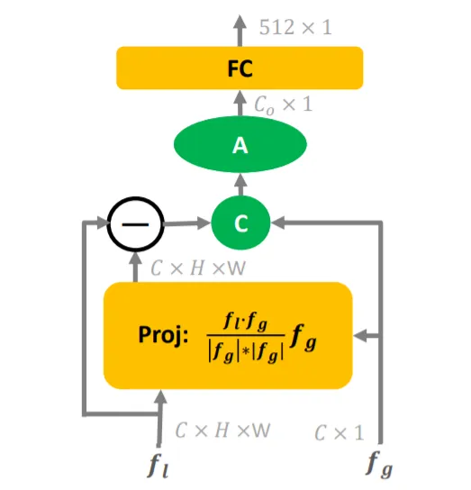
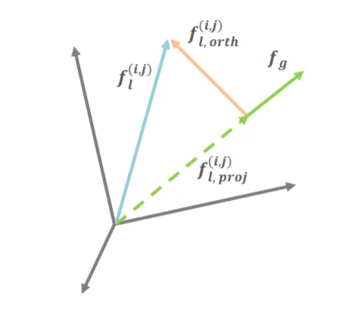
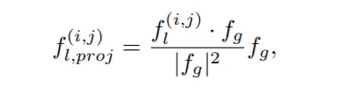
Proposed methods
Resnet50 with Deep Orthogonal Local and Global (DOLG)
Global branch: generating a global descriptor for the image, encapsulates the overall information of the image, providing a holistic understanding of the object.
Orthogonal Fusion Module: Taking global branch and local branch as input, calculate the projection of each local feature point on the global feature
Orthogonal Fusion Module

Slide 38
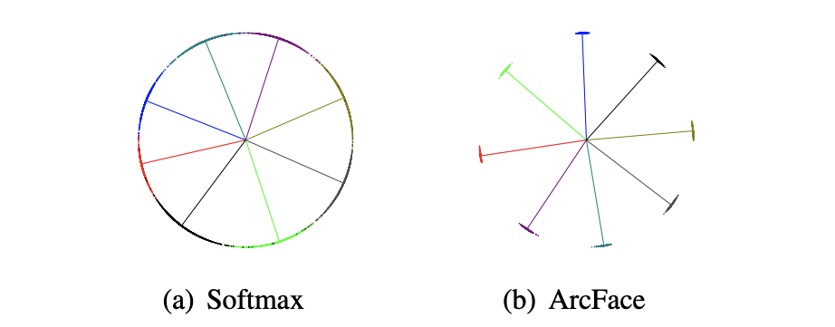
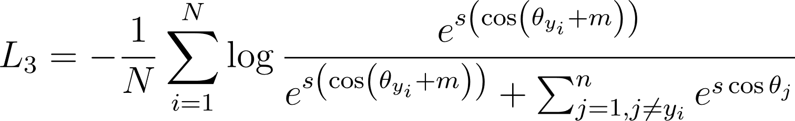
Proposed methods
Resnet50 with Deep Orthogonal Local and Global (DOLG)
ArcFace head loss (Additive Angular Margin Loss): loss function designed to improve the discriminative power of embeddings, used in conjunction with the local and global features to ensure high-accuracy for landmark recognition task.
In a standard softmax loss, the decision boundary is based on the Euclidean distance between feature vectors, but the ArcFace loss applies a margin to the angle between feature vectors.
This angular margin improves network's discriminative ability
ArcFace formula

Slide 39
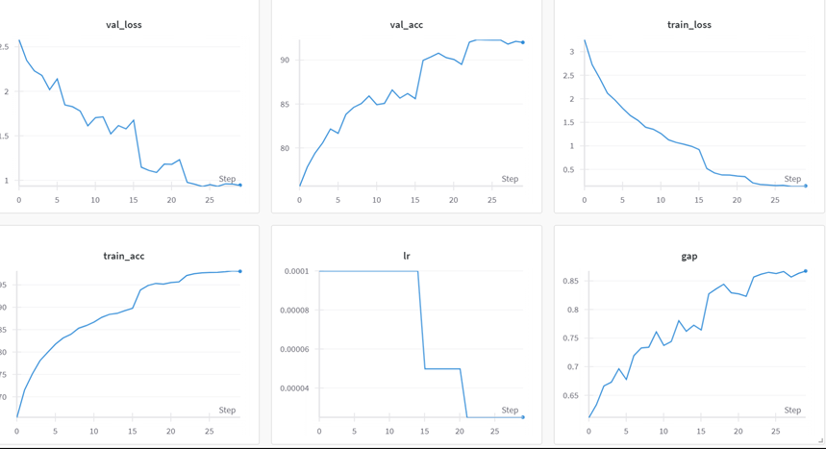
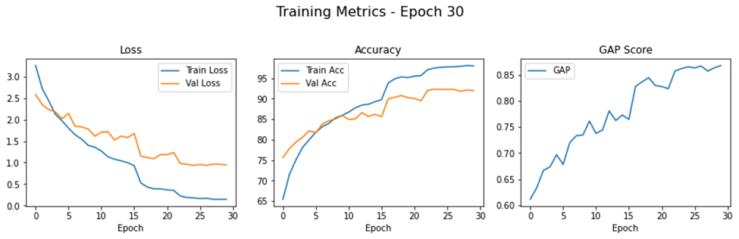
Proposed methods
Resnet50 with Deep Orthogonal Local and Global (DOLG)
Training: We train the model for 30 epochs, using Kaggle T4x2 GPU
The results of the model is as follows
Accuracy | GAP
0.9300 | 0.9320

Slide 40
Evaluation Metrics
+) Overall, the EfficientNet-based models perform better than ResNet base
+) The use of DOLG and DELF architecture increase the score of the base models
+) EfficientNet-B2 + DELF performs the best with a tradeoff of high computational need
Model | Accuracy | GAP score
ResNet50 pipeline1 | 0.9211 | 0.9025
ResNet50 pipeline2 | 0.9088 | 0.9161
EfficientNet-B2 pipeline1 | 0.9700 | 0.9687
EfficientNet-B2 pipeline2 | 0.9549 | 0.9527
ResNet50 + DOLG | 0.9300 | 0.9320
Efficient-B2 +DELF | 0.9845 | 0.9832

Slide 41
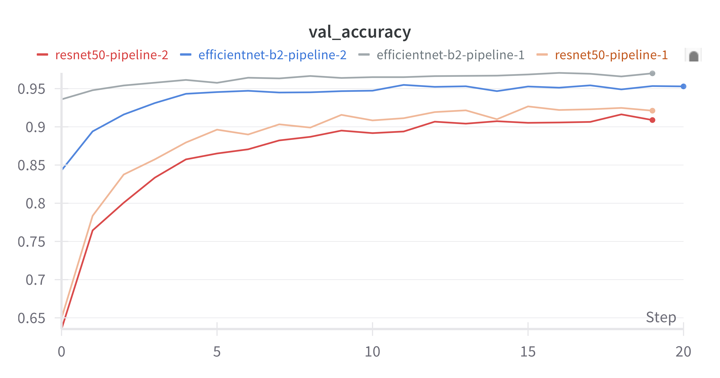
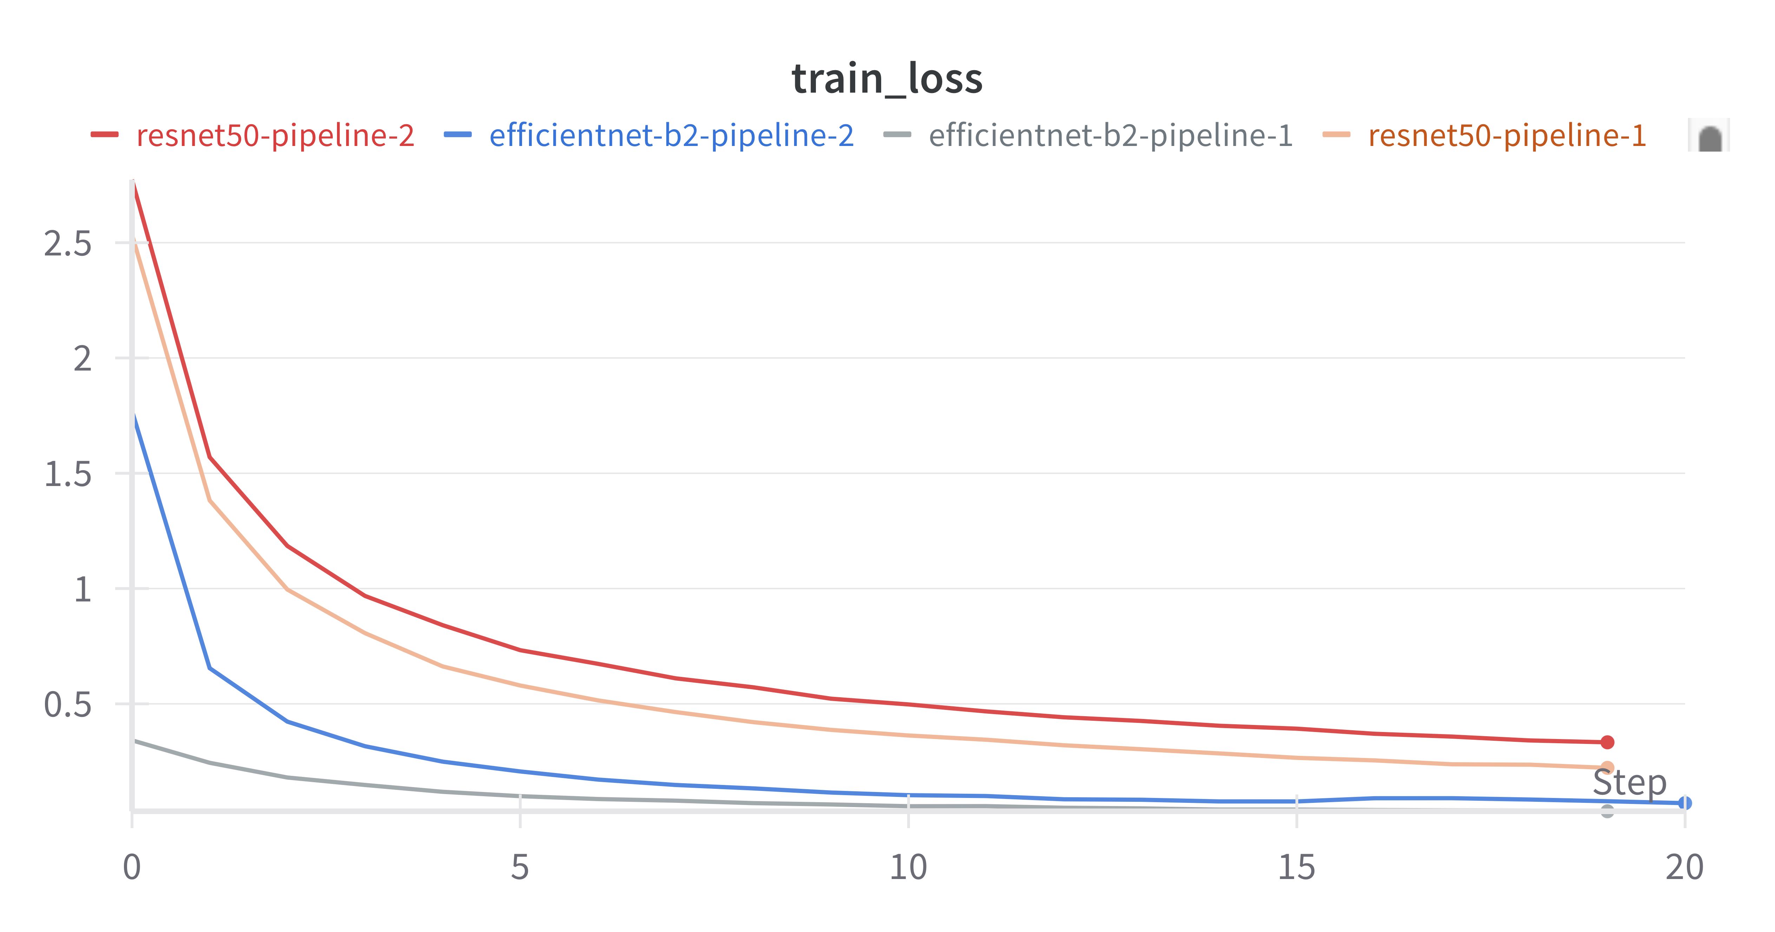
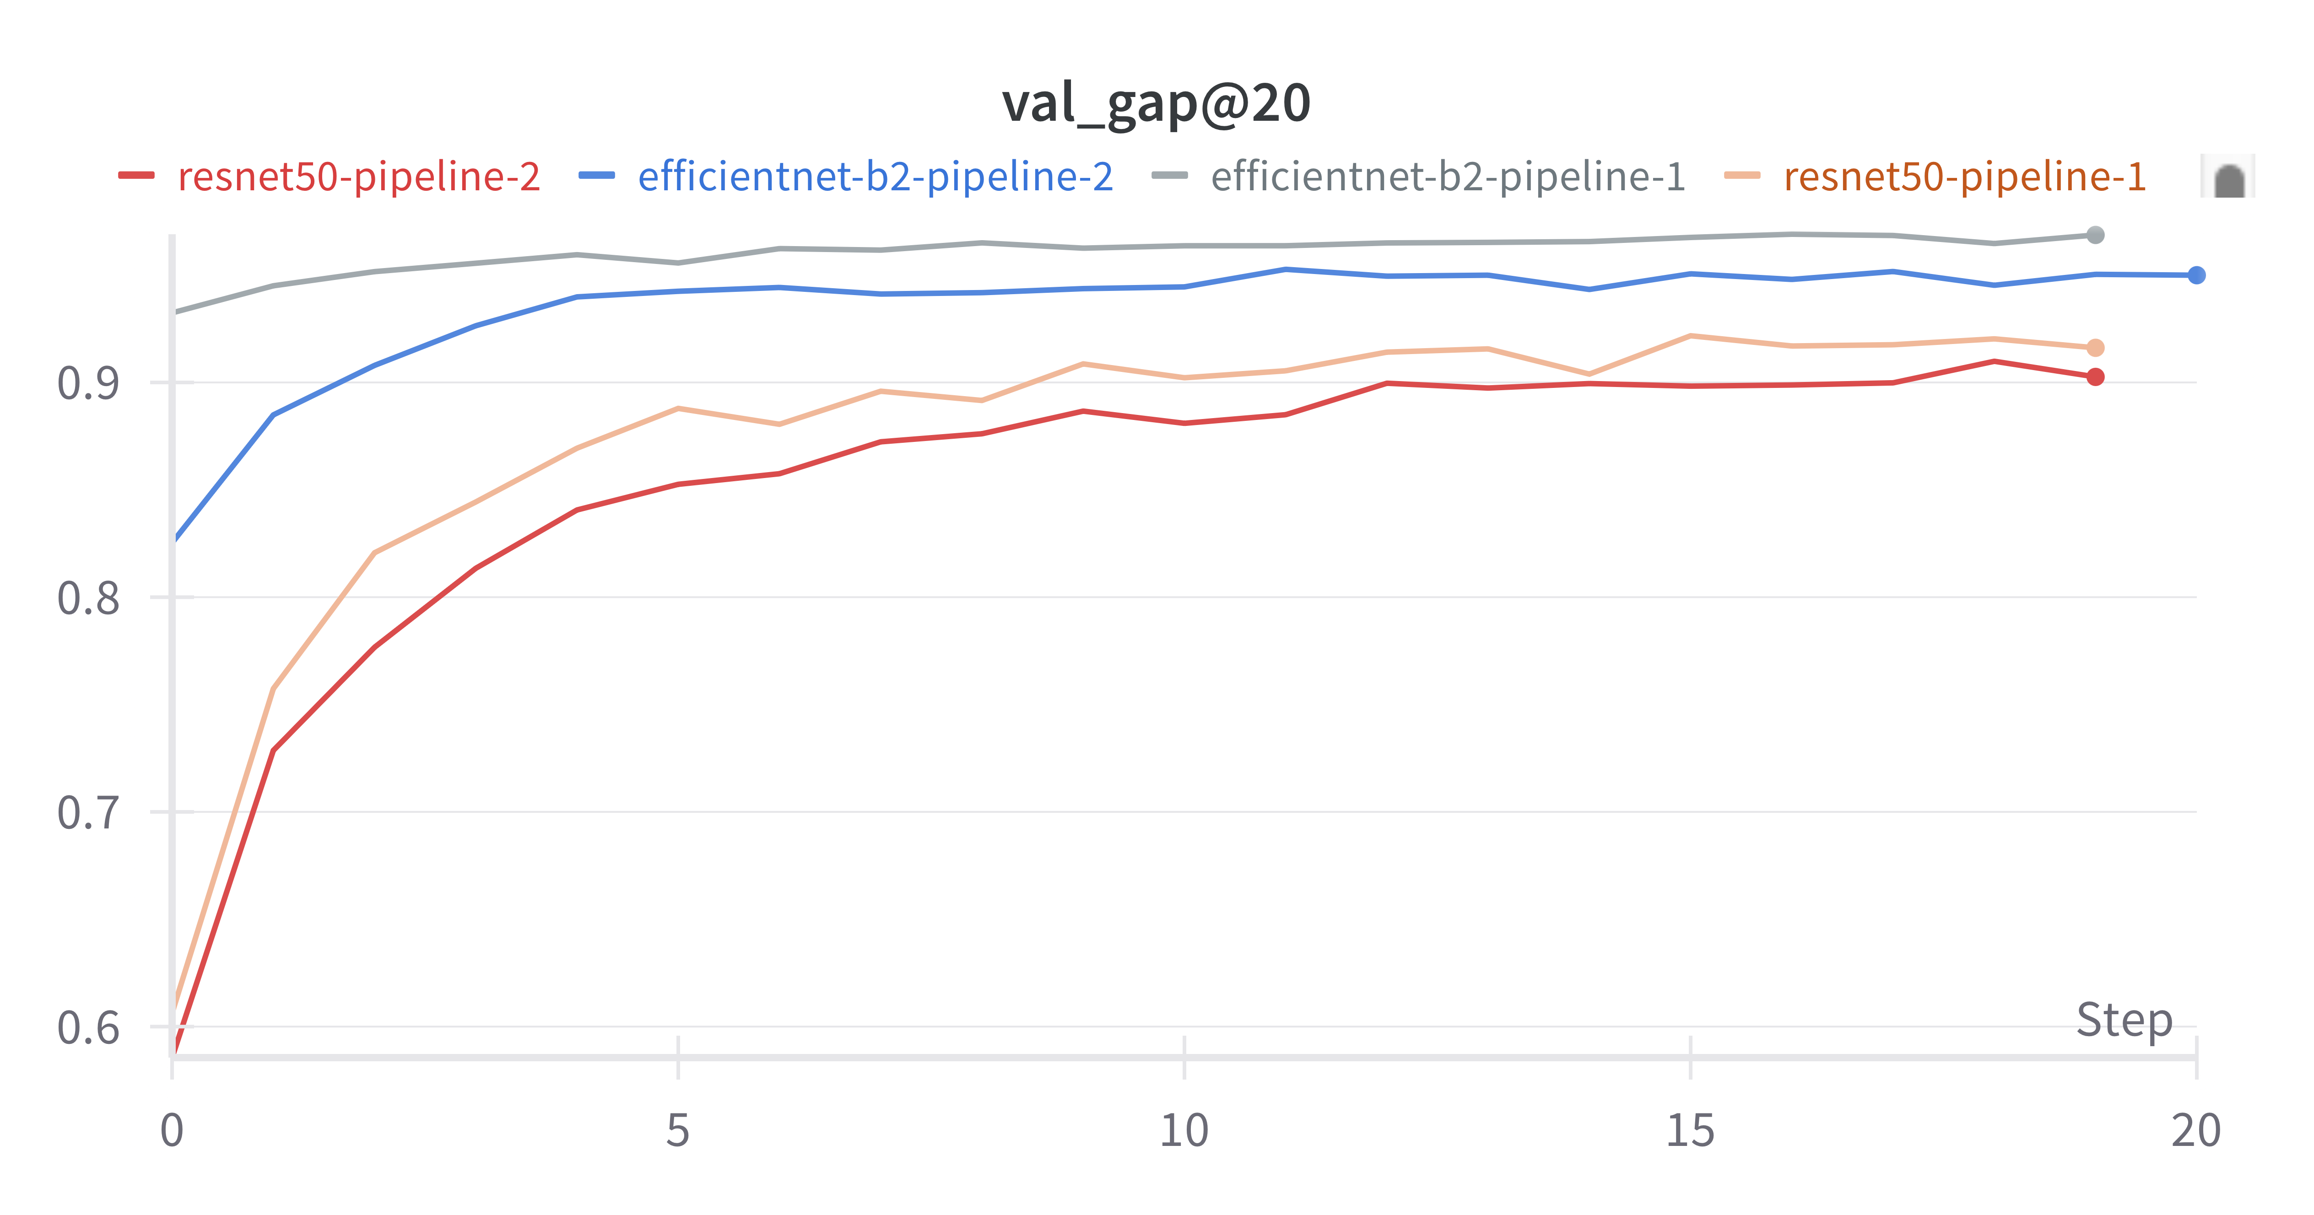
Results
Results
Pipeline 1 is better than Pipeline 2 may be because:
Sharpen reduces blur (Laplacian variance).
CLAHE + HSV improve contrast and color.
No compression, quality preserved.

Slide 42

Handling Out-of-Distribution (OOD) Images
Issue: The models are trained under the assumption that every input image contains a landmark—possibly occupying only a small portion of the image. However, in real-world scenarios, this assumption may not always hold true. Models may produce over-confident predictions for unknown object not appear in train dataset
Problem statement: To address this challenge, we propose a robust landmark recognition pipeline that can detect the absence of known landmarks and reduce false confidence in the presence of unfamiliar visual data.
Our solutions:
1) Add a Binary Classifier for Landmark Detection layer
2) Add an ODIN (Out-of-Distribution detector for Neural networks
3) Feature Matching via Cosine Similarity

Slide 43
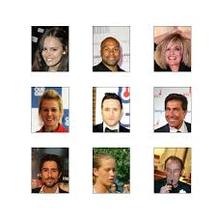
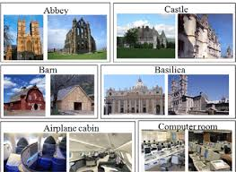
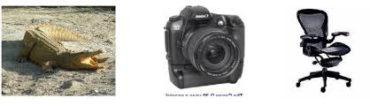
Handling Out-of-Distribution (OOD) Images
Non-landmark images:
We combine images from 3 sources
+) Caltech101: 9,146 images across 101 object categories
+) CelebA: 10,000 images of celebrity faces
+) SUN397: 14 scene categories, 700 images (art school, bakery_shop, street,etc)
Total: 19783 landmark images (About 70 images/landmark) along with 19380 non-landmark images
Caltech101
CelebA
SUN397

Slide 44
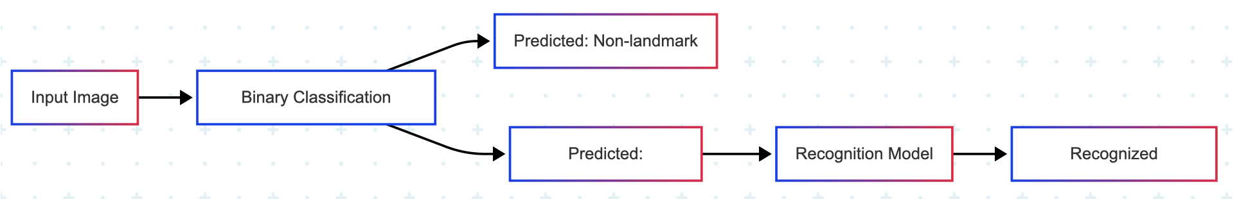
Handling Out-of-Distribution (OOD) Images
Binary Classifier for Landmark Detection
Introduce a MobileNet classifier to first predict the presence or absence of a known landmark in an image before making fine-grained landmark predictions.
+) Input: 20000 images containing landmark and 20000 images that doesn't
+) Output: Label 1/0 whether the image contains a landmark
=> We want the model to capture some basic features of landmark/non-landmark images

Slide 45


Handling Out-of-Distribution (OOD) Images
Binary Classifier for Landmark Detection
Introduce a MobileNet classifier to first predict the presence or absence of a known landmark in an image before making fine-grained landmark predictions.
+) Input: 20000 images containing landmark and 20000 images that doesn't
+) Output: Label 1/0 whether the image contains a landmark
Metrics | Value
Accuracy | 0.8915
Precision | 0.8492
Recall | 0.9520
F1Score | 0.8977

Slide 46
Handling Out-of-Distribution (OOD) Images
Out-of-Distribution Detector for Neural Networks
ODIN (Out-of-Distribution detector for Neural networks) is a method designed to detect whether an input image is in-distribution (ID) (i.e. from the same domain as the training data) or out-of-distribution (OOD) (i.e. something the model hasn’t seen before).
ODIN enhances the softmax output of a neural network to amplify the separation between in-distribution and out-of-distribution samples
The ODIN score is the maximum softmax probability of a neural network’s output after applying two tweaks: Temperature Scaling (T) and Input Perturbation (ε)
In-Distribution samples tend to have higher softmax confidence (i.e., higher ODIN scores), while Out-Of -Distribution samples have more uniform, uncertain outputs (i.e., lower ODIN scores)."

Slide 47

Handling Out-of-Distribution (OOD) Images
Out-of-Distribution Detector for Neural Networks
Scoring: The max softmax probability of the perturbed input is used as a confidence score
Do gridSearch on hyperparameters (temperature and epsilon) to find the best threshold value
=> Optimal threshold value (Youden's J): 0.6451
Metrics | Value
Accuracy | 0.54
Precision | 0.54
Recall | 0.55
F1Score | 0.54

Slide 48

Handling Out-of-Distribution (OOD) Images
Feature Matching via Cosine Similarity
Perform embedding-based comparisons between input images and known landmark features using cosine similarity to verify landmark presence in a model-agnostic way.
Feature Extraction: A CNN (ResNet-50) is used to extract a fixed-length feature vector from the input image.
2 sets of precomputed features are used:
+) landmark_features.npy: Embeddings of landmark images.
+) non_landmark_features.npy: Embeddings of non-landmark images
Cosine similarity is calculated between the new image’s feature vector and all reference vectors. If the max similarity to landmarks exceeds a threshold and is greater than the non-landmark similarity, it's classified as a Landmark, else Non-Landmark
Cosine Similarity formula for 2 vectors

Slide 49




Handling Out-of-Distribution (OOD) Images
Feature Matching via Cosine Similarity
Our implementation takes an input image through A CNN-base model to extract features then compare with the embedding database

Slide 50

Handling Out-of-Distribution (OOD) Images
Feature Matching via Cosine Similarity
Our implementation takes an input image through A CNN-base model to extract features then compare with the embedding database
Metrics | Value
Accuracy | 0.9585
Precision | 0.9305
Recall | 0.9910
F1Score | 0.9598

Slide 51

Evaluation Metrics and Results
Accuracy – Correct classification rate
$Accuracy= \frac{TP+TN}{TP+TN+FP+FN}$
Precision/Recall – Balance between false positives & false negatives
$Precision= \frac{TP }{TP+FP}$ $Recall= \frac{TP}{TP+FN}$
Model | Accuracy | Precision | Recall
MobileNet Binary Classifier | 0.8915 | 0.8492 | 0.9520
Odin Score | 0.54 | 0.54 | 0.55
Feature Extraction | 0.9585 | 0.96 | 0.96

Slide 52
Table of contents
Problem description
Dataset
Methodologies
Evaluation and Results
Demo

Slide 53
Results
Results
Landmark recognition
Model | Accuracy | GAP score
ResNet50 pipeline1 | 0.9211 | 0.9025
ResNet50 pipeline2 | 0.9088 | 0.9161
EfficientNetB2 pipeline1 | 0.9700 | 0.9687
EfficientNetB2 pipeline2 | 0.9549 | 0.9527
ResNet50 + DOLG | 0.9300 | 0.9320
EfficientB2 +DELF | 0.9845 | 0.9832
Landmark, non-landmark classification
Model | Accuracy | Precision | Recall
MobileNet Binary Classifier | 0.8915 | 0.8492 | 0.9520
Odin Score | 0.54 | 0.54 | 0.55
Feature Extraction | 0.9585 | 0.96 | 0.96

Slide 54

Results
Results
Conclusion
Overall, this project has implemented different approaches to tackle the task of recognize 100 landmarks and deal with out-of-distribution landmark images,
EfficientNet with DELF gives the best results overall, in exchange for need of long training time and high computational resources
EfficientNet models can perform better than ResNet in the task Landmark Recognition
The use of Feature extraction outperforms other method in both image recognition and classification. ODIN might not be suitable for the task
Future work
+) Implement more diverse methods/models on recognition and dealing with OOD
+) Train with more landmarks to submit for the competition
+) Use different algorithms to improve performance of base model.

Slide 55
Table of contents
Problem description
Dataset
Methodologies
Evaluation and Results
Demo

Slide 56
THANK YOU !

